Slide 1

MS SQL Server
Course Introduction
SoftUni Team
Technical Trainers
Software University
https://softuni.bg/

Slide 2
Table of Contents
Course Objectives
Training and Team
Course Organization
Course Infrastructure
Evaluation Criteria
2

Slide 3
Have a Question?
sli.do
#csharp-db

Slide 4














SoftUni Diamond Partners

Slide 5

Educational Partners

Slide 6

Course Objectives

Slide 7
C# Database Fundamentals Module Goals
Basic Database and Query Concepts
Content: SQL syntax, Data types, Programmability
ADO.NET Library
ORM Fundamentals
Entity Framework Core
Automapper Library and
Best Practices and Architecture
Workshop
7

Slide 8
Course Objectives
DB Intro, Data Definition and Data Types
Basic CRUD, Intro to SQL
Built-in functions with T-SQL
Data Aggregation
Table Relationships
Subqueries and Joins
Database Programmability
8

Slide 9
Practical Programming Exam
12 practical problems for 4 hours
DDL
DML
Querying
Programmability
Automated judge system
http://judge.softuni.bg
Solutions are evaluated for correctness only
Code quality is still not measured
9

Slide 10
Theoretical Exam
You will have 30 minutes once you enter
English
Automated quiz system
Available during the practical exam and 30 minutes after it
You can submit your answers just one time
10

Slide 11

The Team

Slide 12
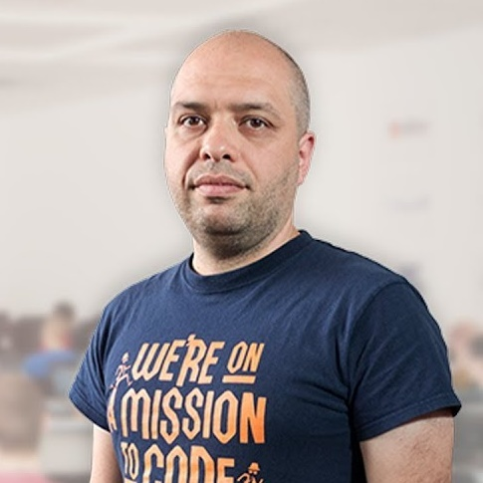
Stamo Petkov
Head оf Department @ Information Services Plc.
Worked with various technologies
.NET and C#, BASIC, Pascal, Object Pascal, PHP
20 years of experience
Experienced Lecturer
C# Basics and ASP.NET Core @ Softuni

Slide 13
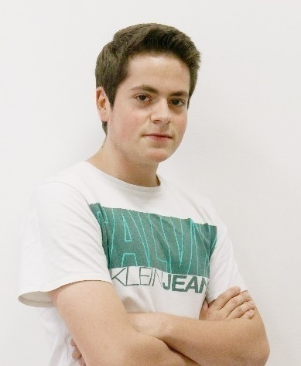
Kristiyan Ivanov
Top Student @ SoftUni
Technical Trainer @ SoftUni
Student @ Technical University of Sofia
Interests include mechanics and electronics
Automotive Software Development
Interested in coding with C#, Python, C++

Slide 14

Course Organization

Slide 15
C# Database Fundamentals Module – Timeline
10-Jan-2023
12-Feb-2023
14-Feb-2023
01-Apr-2023
04-Apr-2023
11-Apr-2023
MSSQL
5 weeks * 4 times / week
9 credits
Start: 10-Jan-2023
Exam: 12-Feb-2023
Retake exam: 04-Apr-2023
Entity Framework Core
7 weeks * 4 times / week
15 credits
Start: 14-Feb-2023
Final exam: 01-Apr-2023
Retake exam: 11-Apr-2023

Slide 16


SoftUni Certificate
Practical Exam 100%
Homework 5%
Evaluation
16

Slide 17
CPE Certificate
Practical Exam
Theoretical Exam
Evaluation
17

Slide 18

Homework Assignments & Exercises
Your homework is mainly work in class
Lesson days → slides + live demos + exercises
Exercise days → only exercises
How to submit your homework?
Submitted in the judge system
Do your homework when it's due
Assignments pile up quickly

Slide 19


Learn to Search in Internet
The course assignments require to search in Internet
This is an important part of the learning process
Some exercises intentionally have no hints
Learn to find solutions!
Software development includes everyday searching and learning
No excuses, just learn to study!
Developers learn new technologies, tools, languages every day!

Slide 20



Course Web Site, Forum and FB Group
Official web site:
Official discussion forum:
Official Facebook group:
https://softuni.bg/trainings/3965/ms-sql-january-2023
https://softuni.bg/forum/categories/63/module-csharp-db
https://www.facebook.com/groups/CsharpDBJanuary2023

Slide 21
Questions?
Notes:
21

Slide 22
Trainings @ Software University (SoftUni)
Software University – High-Quality Education, Profession and Job for Software Developers
softuni.bg, about.softuni.bg
Software University Foundation
softuni.foundation
Software University @ Facebook
facebook.com/SoftwareUniversity
Software University Forums
forum.softuni.bg
22
Notes:
22

Slide 23

License
This course (slides, examples, demos, exercises, homework, documents, videos and other assets) is copyrighted content
Unauthorized copy, reproduction or use is illegal
© SoftUni – https://about.softuni.bg
© Software University – https://softuni.bg
Notes:
23

